Slide 1
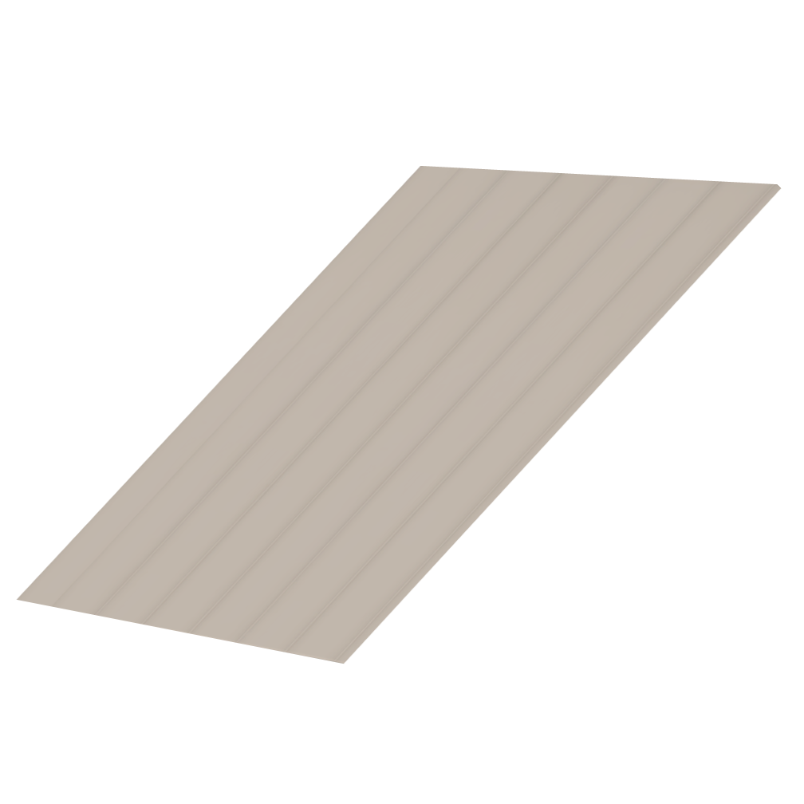
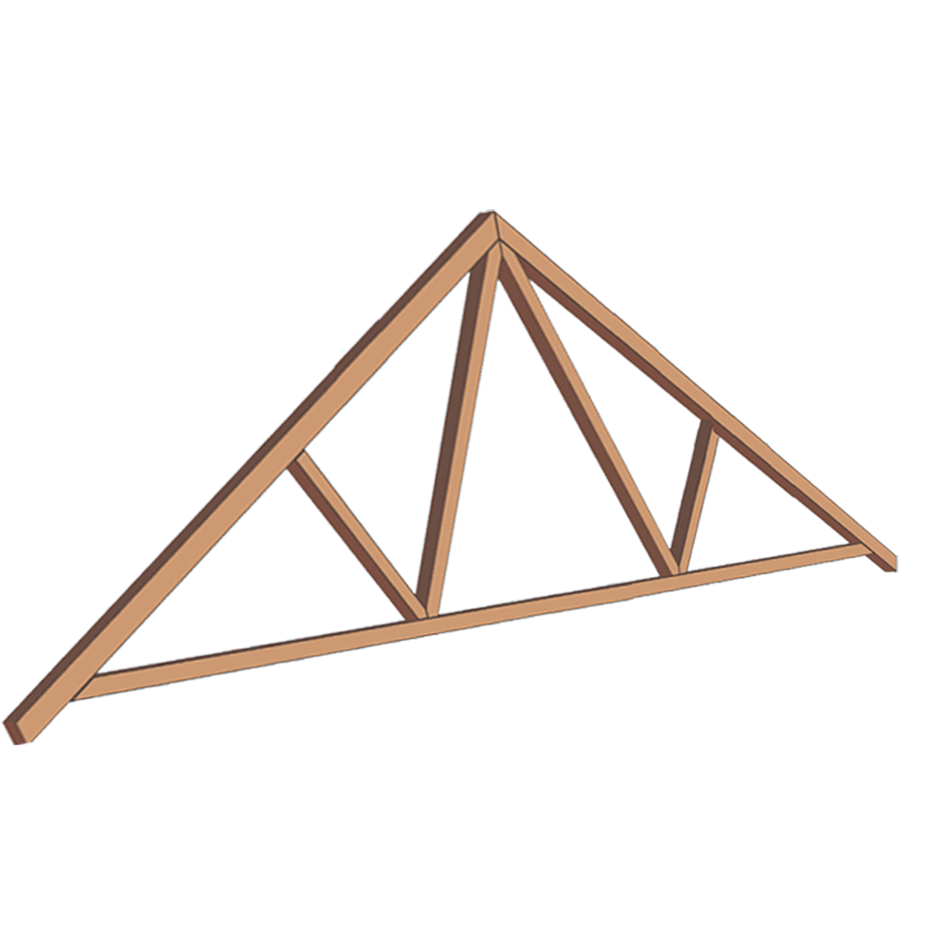
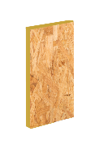
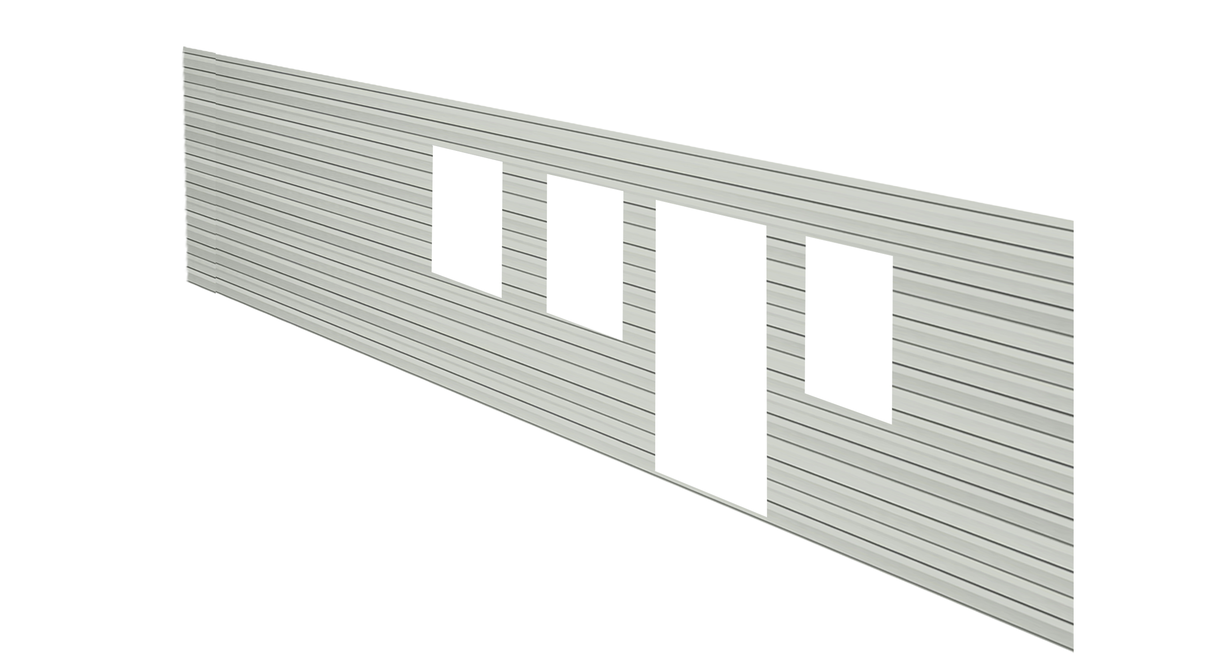
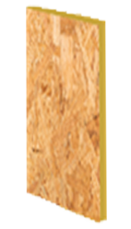
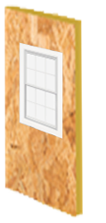
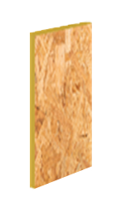
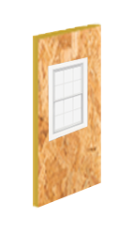
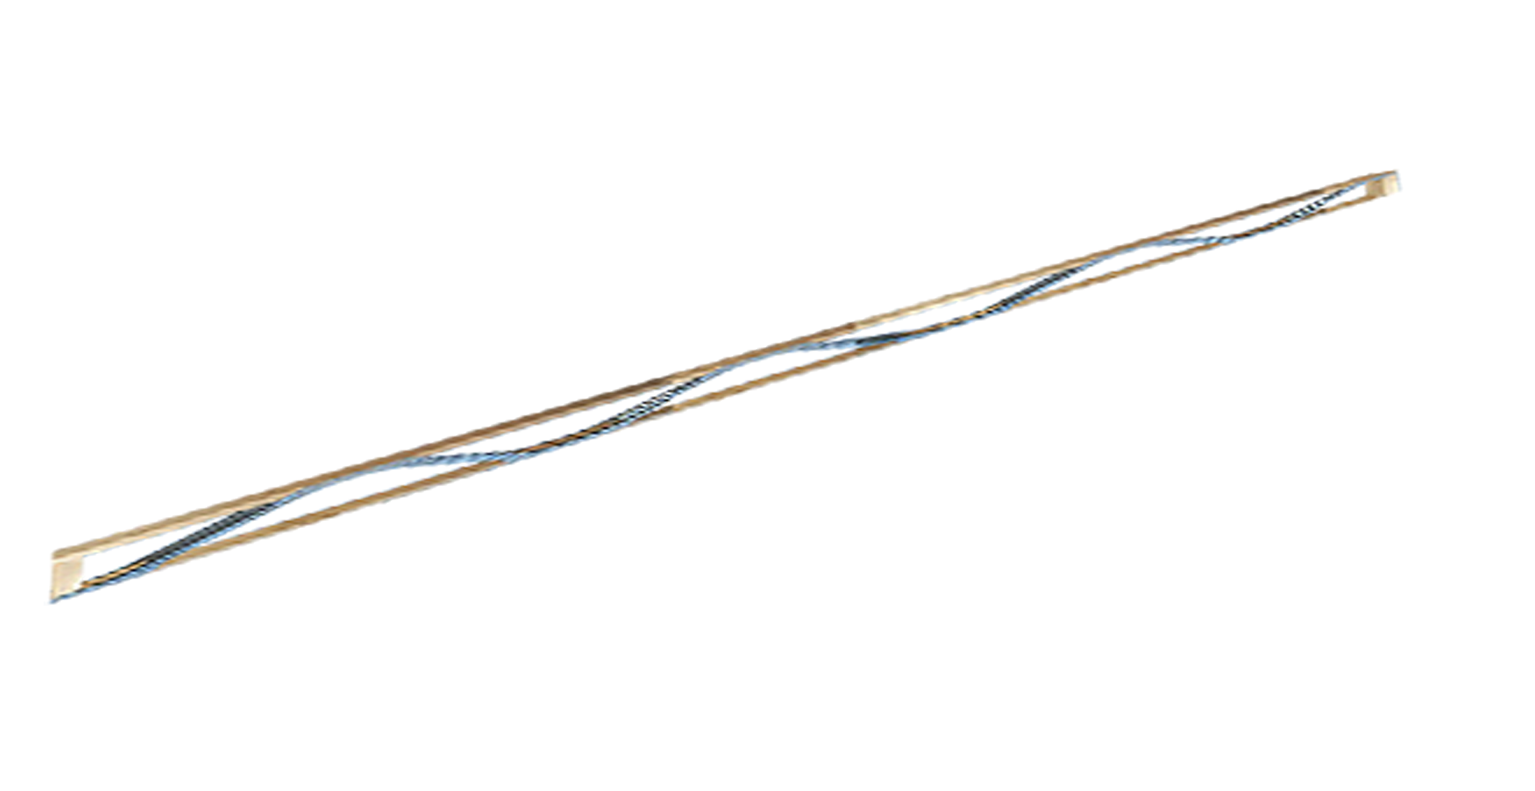
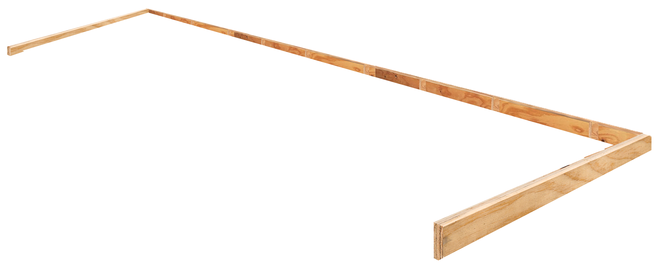
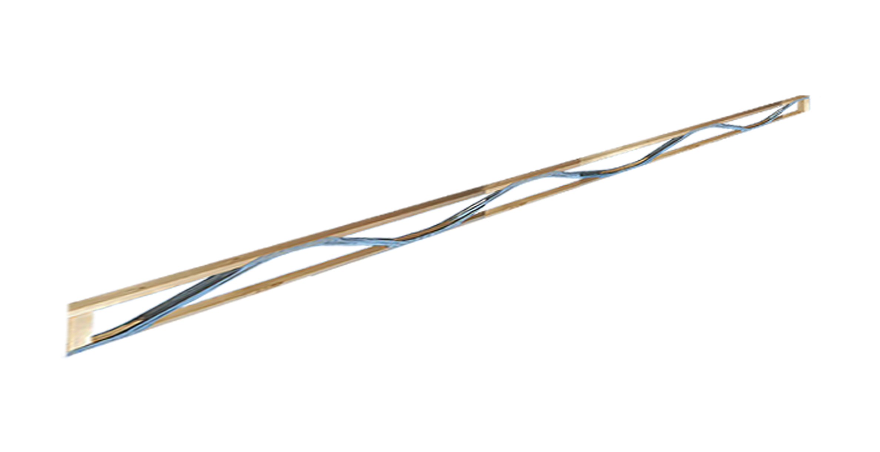
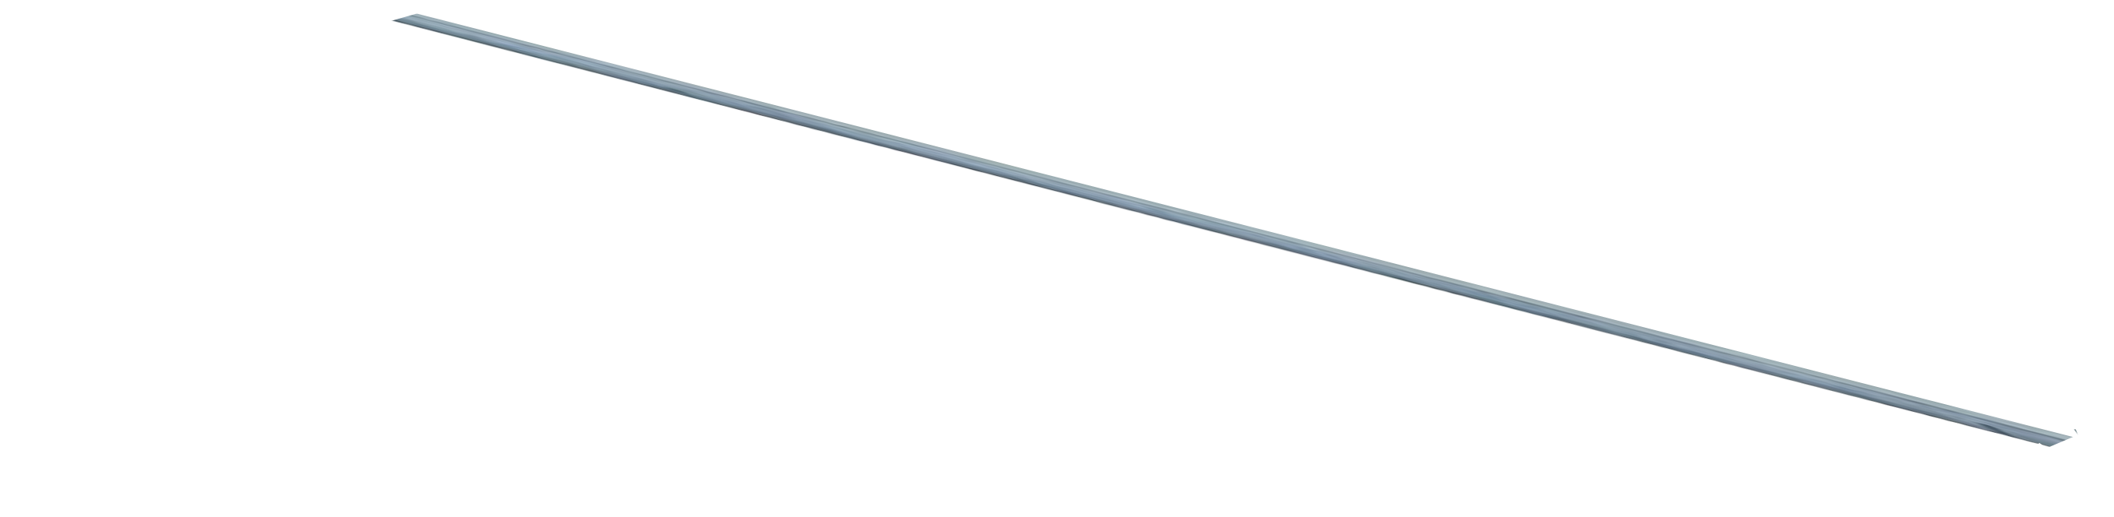
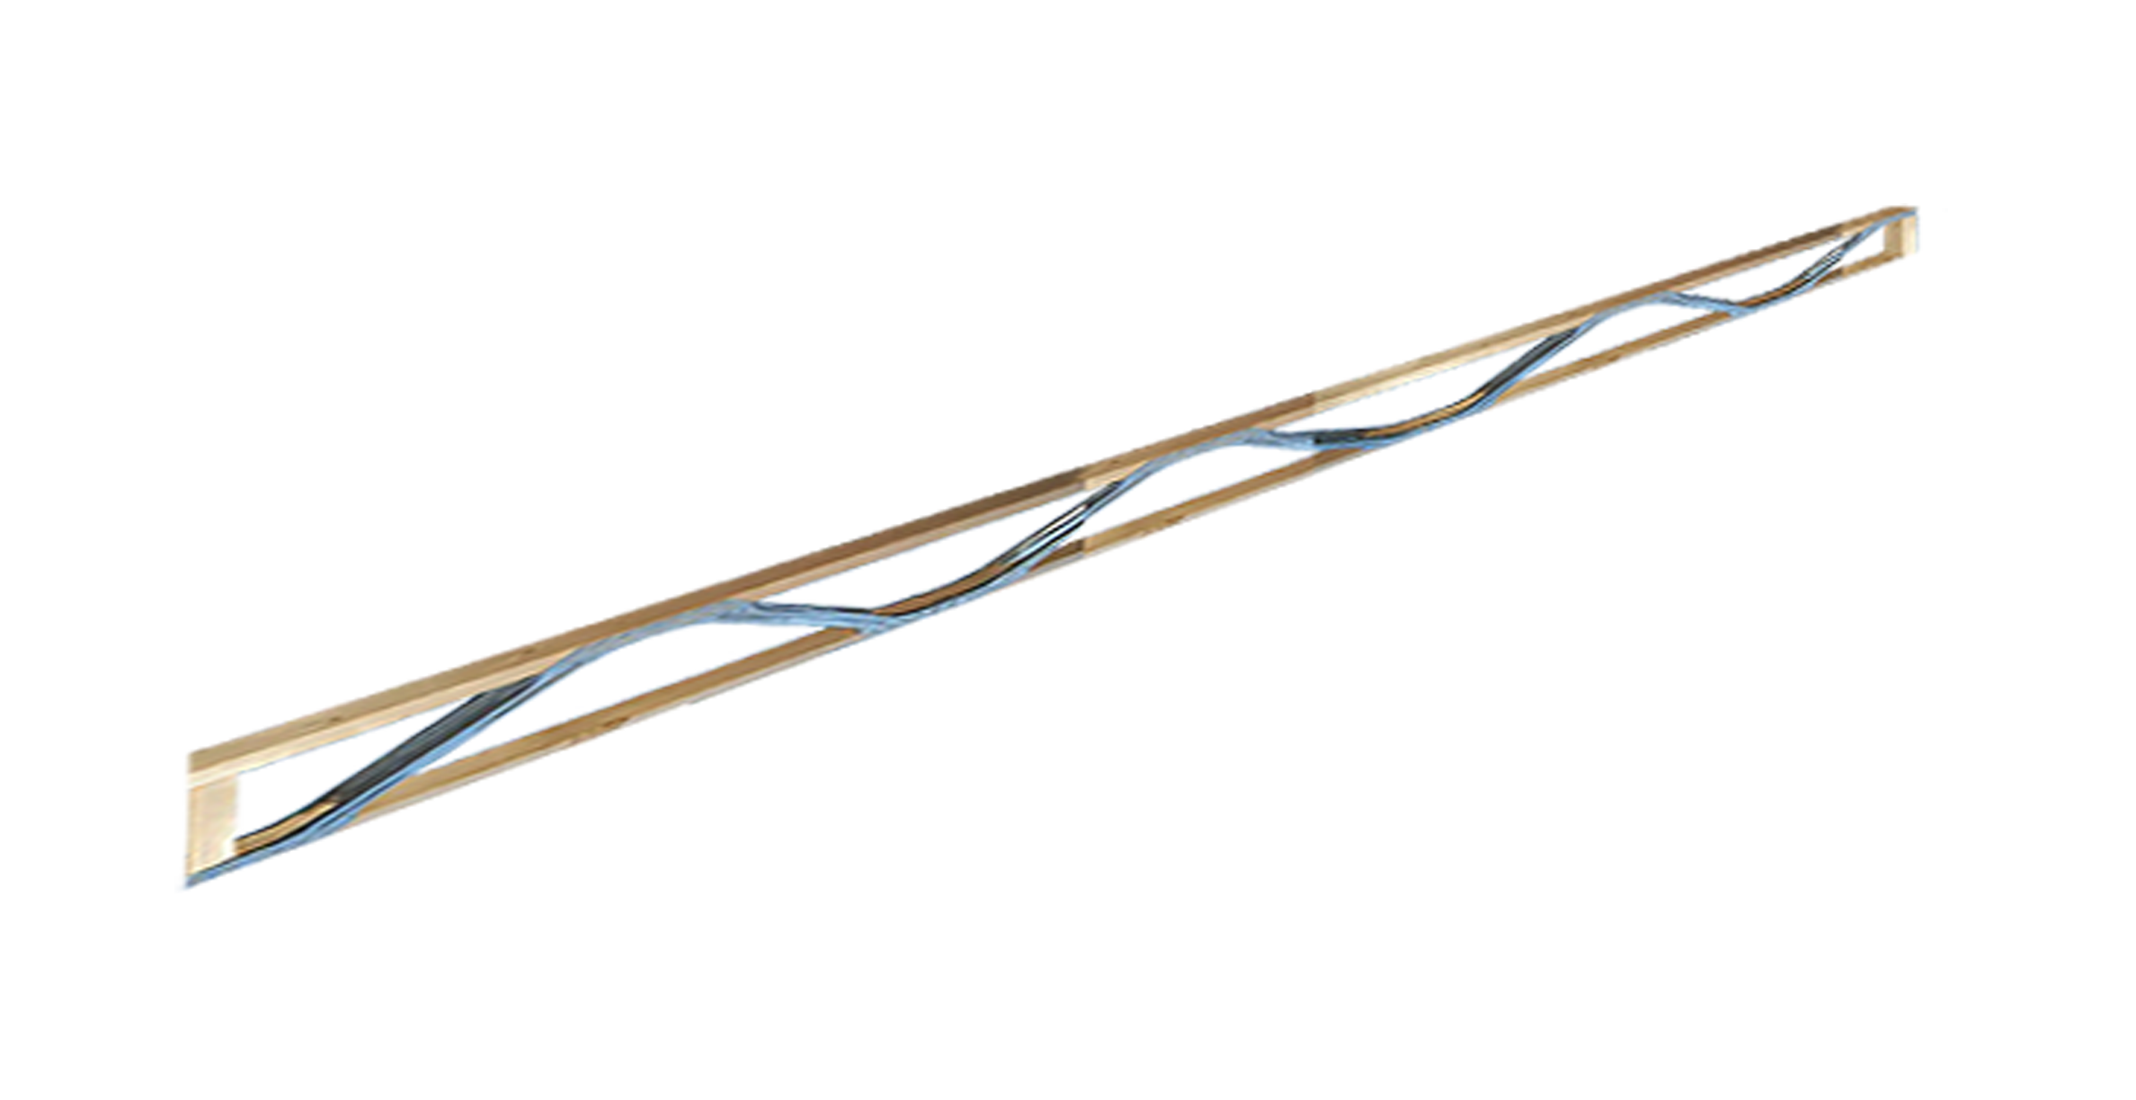
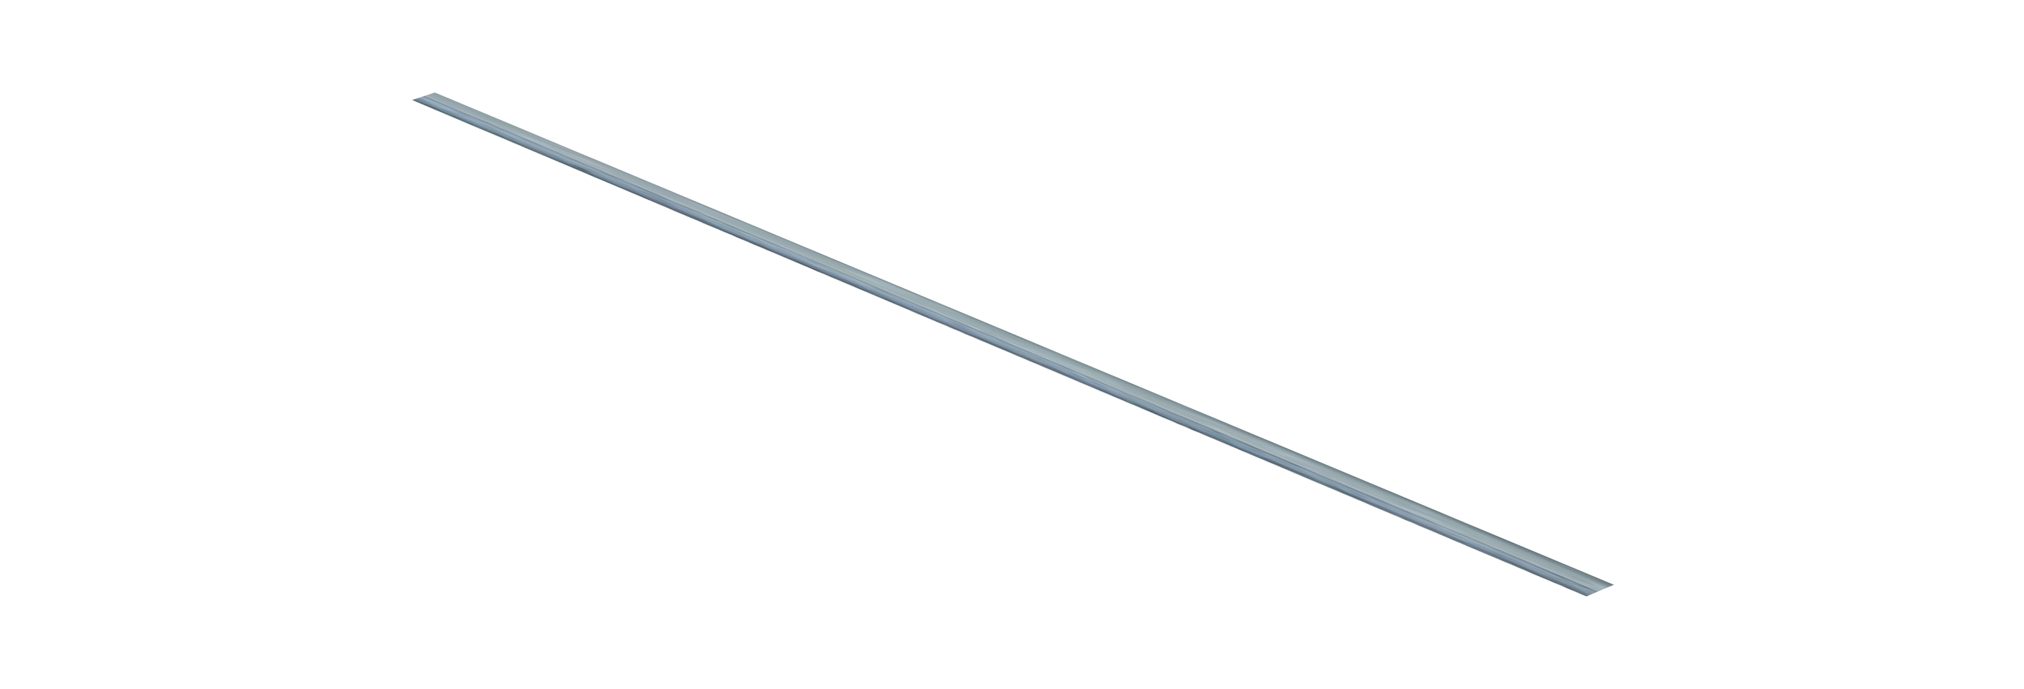
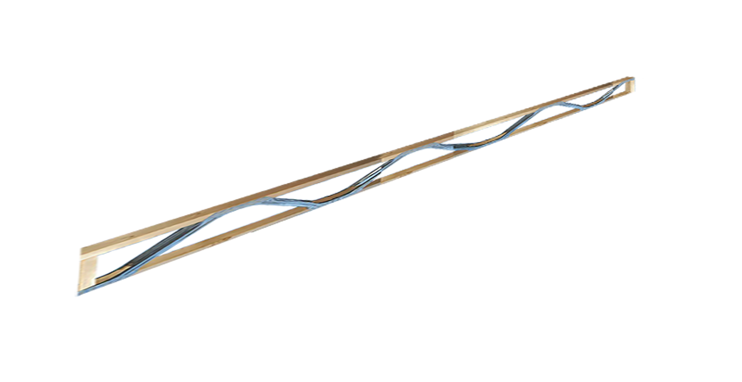
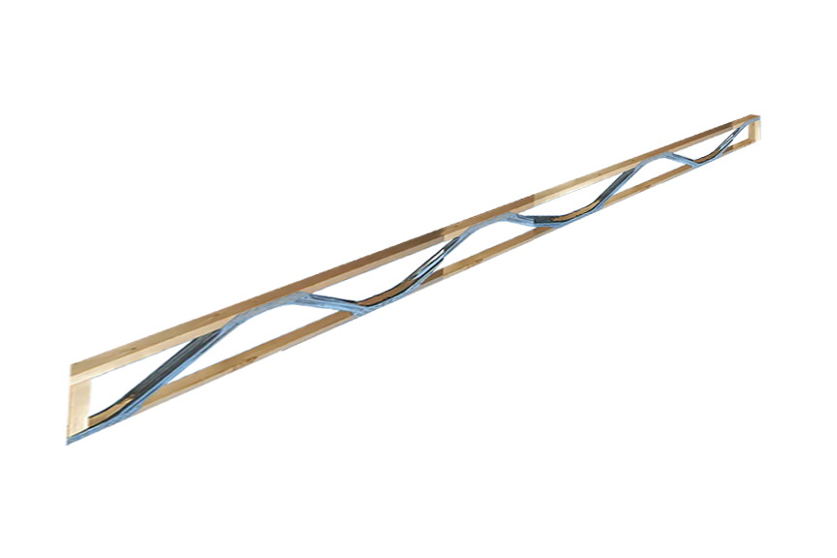
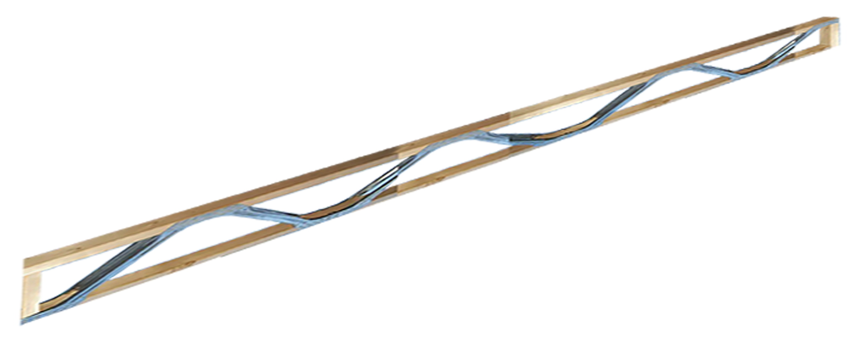
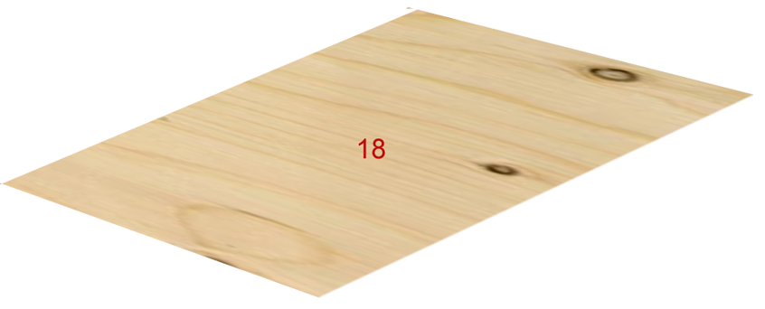
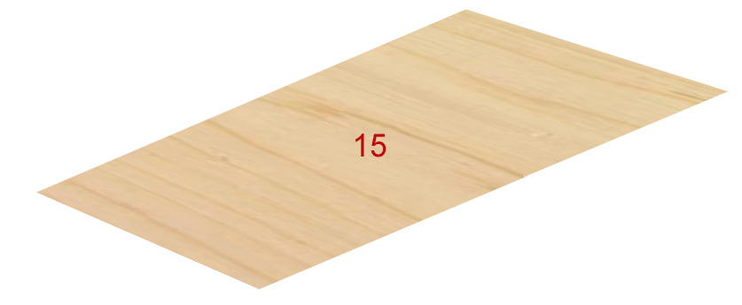
S.C.H. Rapid Assembly Home System
A 1,500 SF WEATHER-TIGHT SHELL COMPLETED IN 2 DAYS.
Why the SCH System Works: “High Tolerance to Assembly Defects“
The ability to accommodate human error and onsite variables is crucial to the assembly process. The SCH designs are integrated into various aspects of the SCH system allowing installers the capability to backtrack, identify assembly issues, and rectify errors that may have arisen during the buildout process. This functionality facilitates the correction of layout discrepancies, panel installations, and utility functions that may have been improperly executed. Our panel design offers an efficient and effective approach to addressing these challenges as they emerge.
Welcome Home
Underground Utilities & Concrete Pad Ready for Installation of a ICHS Residence
Click to Advance

Slide 2
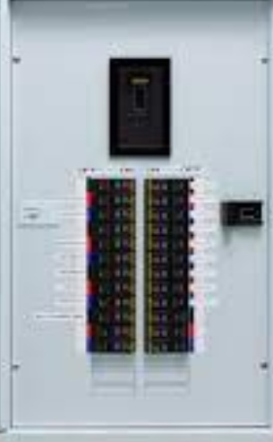
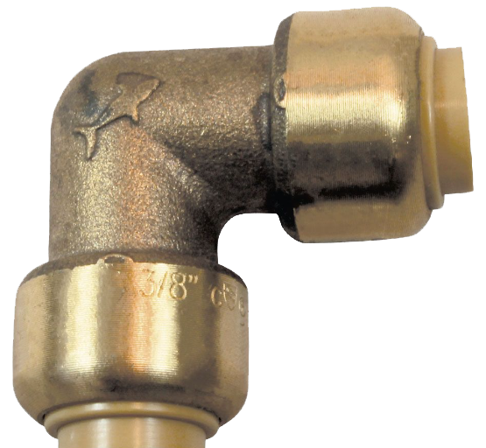
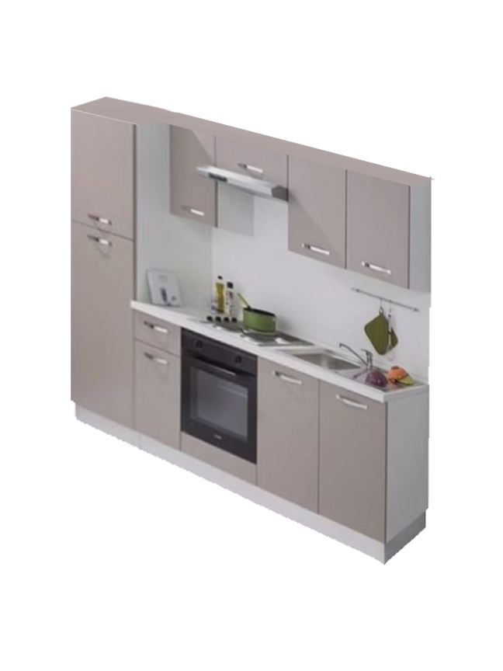
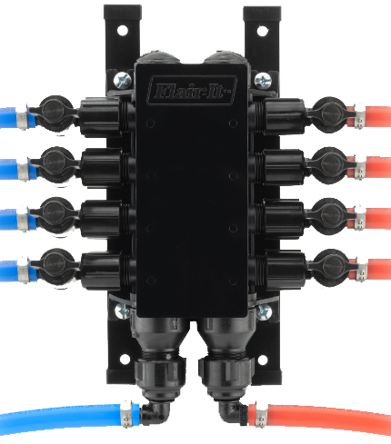
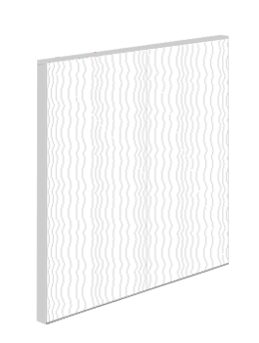
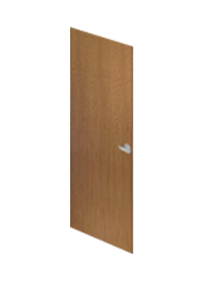
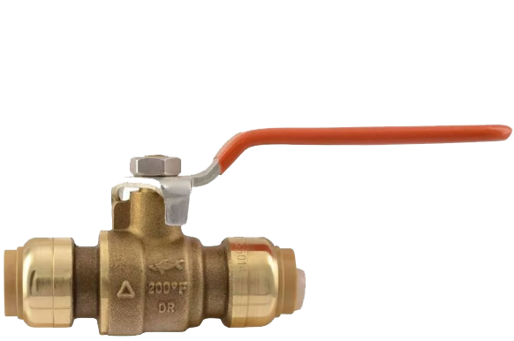
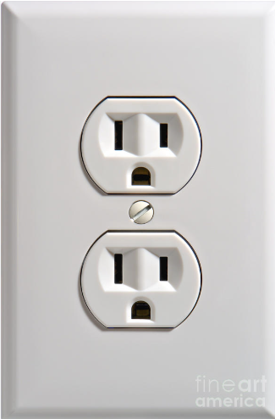
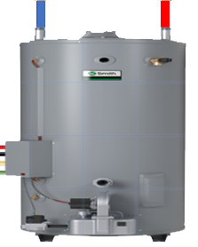
Assembly Sequence
Quoted completion times in this presentation are based on a typical 1,500 sf home. S.C.H. Proprietary devices incorporated into the assembly process.
6) Utilities
Ready to Assemble
Electrical – Plumbing – HVAC
CLICK TO ADVANCE
1) Slab Foundation or Framed Floor Deck
Prepared in advance of the ICHS Home
5) Interior Wall System
The perimeter panels are installed via a simple fastening system.
CLICK TO ADVANCE
11) Ceiling Grid System
Capable of receiving drywall or a finished clip plank. END
3) Perimeter Wall System
The perimeter panels are installed via a simple fastening system.
CLICK TO ADVANCE
2) EPS Structural Walls
The perimeter panels are installed with the exclusive SCH track system.
EPS Structural Walls
The perimeter panels are installed with the TAP fastening system.
CLICK TO ADVANCE
3) Perimeter Wall System
Our exclusive perimeter panels are installed in less then 60 minutes.
4) Pinch Tracks
Panels are installed into pinch tracks. The tracks are relocatable during the install process and are then subsequently installed permanently.
CLICK TO ADVANCE
4) Interior Wall System
The perimeter panels are equipped with preinstalled utility functions, significantly reducing the time required for the overall completion of a new home.
Slab Foundation
Prepared in advance of the construction of a ICHS Home
CLICK TO ADVANCE
7) Flooring / Tile
Conventional flooring and tile installs.
CLICK TO ADVANCE
5) Utilities
Rapid connection of electrical and plumbing systems via a coded and easy to follow plan
8) Onsite Cut &
Preassembled Millwork
Window extension jambs w/ casings preassembled w/ all doors preinstalled.
CLICK TO ADVANCE
6) Flooring / Tile
Conventional flooring and tile installations can be conducted prior to the assembly of interior walls to enhance the efficiency of the overall completion timeline.
9) Cabinetry – Millwork
Now ready for installation.
CLICK TO ADVANCE
Pinch Track
8) Onsite Cut & Preassembled Millwork
Window extension jambs w/ casings preassembled w/ all doors preinstalled.
Click to Advance
10) Plumbing Fixtures
The home is now prepared for the installation of the plumbing fixtures.
CLICK TO ADVANCE
9) Cabinetry – Millwork
Now ready for installation.
Pinch Track
10) Plumbing Fixtures
The home is now prepared for the installation of the plumbing fixtures.
11) Ceiling Grid System
Capable of receiving drywall or a finished clip plank

